Slide 1
Actividades naturales
Infografía
Here is where your presentation begins

Slide 2
About nature activities
binder infographics
This template contains an assortment of complementary infographic resources for the Nature Activities Binder presentation.
These infographics are adapted to the style of the aforementioned presentation, so you can insert them easily and have them completely integrated at once. You just need to do the following:
Select the element that you want to copy
Right-click and choose “Copy”
Go to the slide where you want the element to appear
Right-click and choose “Paste”

Slide 3
Nature activities binder infographics
Priorities
Coming up
Notes
Schedule day
Despite being red, Mars is a cold place
Venus has a beautiful name, but it’s hot
Read a book
Paint a picture
Mercury is the closest planet to the Sun
Relax
Neptune is very far from the Sun

Slide 4
Nature activities binder infographics
January 2022
Mon | Tue | Wed | Thu | Fri | Sat | Sun
 |  |  |  |  | 1 | 2
3 | 4 | 5 | 6 | 7 | 8 | 9
10 | 11 | 12 | 13 | 14 | 15 | 16
17 | 18 | 19 | 20 | 21 | 22 | 23
24 | 25 | 26 | 27 | 28 | 29 | 30
History exam
Despite being red, Mars is a cold place
Maths exam
Venus has a beautiful name, but it’s hot
English exam
Neptune is very far from the Sun

Slide 5
Nature activities binder infographics
M
T
W
T
F
Earth is the third planet from the Sun. It harbors life
Art
Despite being red, Mars is a cold place full of iron oxide dust
Maths
Science
Mercury is the closest planet to the Sun and the smallest one
History
Neptune is the farthest planet and also the fourth-largest

Slide 6
Nature activities binder infographics
07.12
16.12
Science
Language
Exercises 1, 2 and 3
Read a book
Homework
10.12
18.12
Maths
History
Exercises 5 and 7
Text exercises

Slide 7
Nature activities binder infographics
My weekend tasks
Call John and ask for the week
Do homework for the week
Have breakfast with mom
Have a breakfast with the family
Do the tasks for the week
Watch a movie with Anne
Go for a walk with my friends
Make a picture

Slide 8
Nature activities binder infographics
1st semester
Sep
Oct
Nov
Dec
Jan
Feb
Mar
Art collage
English text
Maths
1, 2 science

Slide 9
Nature activities binder infographics
 | Mon | Tue | Wed | Thu | Fri
09:00 |  |  | Jupiter is a big planet |  | Uranus is an ice giant
10:00 | Pluto is a dwarf planet
11:00 |  | Saturn has rings | Mercury is a small planet | Venus is a hot planet
12:00 |  | Earth is where we live |  |  | Neptune is a blue planet

Slide 10
Nature activities binder infographics
6:00-9:00 Hrs
10:00-13:00 Hrs
14:00-17:00 Hrs
Mars
Mercury
Earth
Saturn
Jupiter
Saturn
Venus
Neptune
Venus
Mercury
Mars
Neptune
Wake up
Breakfast
School
Coffee
Play

Slide 11
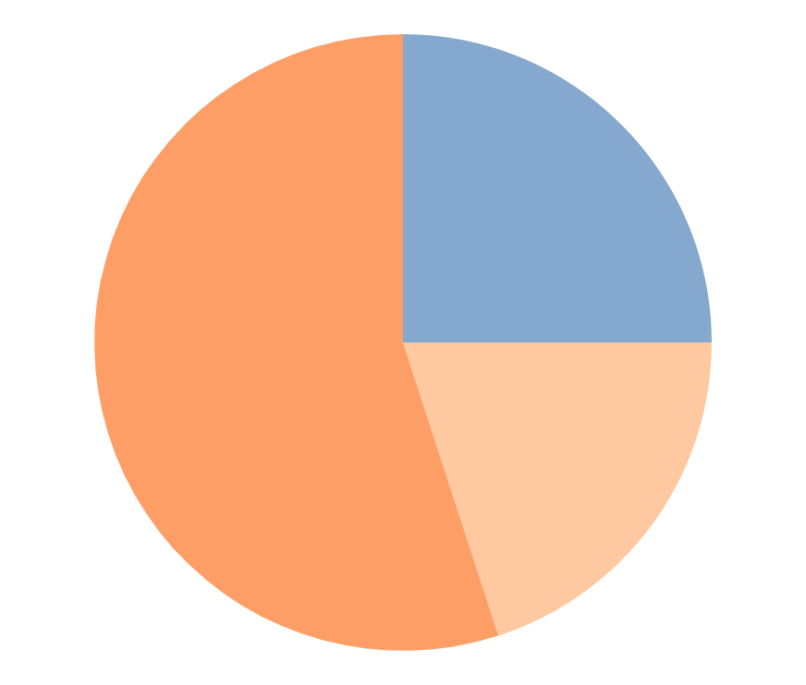
Nature activities binder infographics
Exercises
55%
Venus is the second planet from the Sun
Exams
25%
Earth is the third planet from the Sun
Follow the link in the graph to modify its data and then paste the new one here. For more info, click here
Free time
20%
Despite being red, Mars is a cold place

Slide 12
Nature activities binder infographics
To do
Doing
Done
Task 13
Task 14
Task 15
Task 16
Task 17
Task 18
Task 7
Task 8
Task 9
Task 10
Task 11
Task 12
Task 1
Task 2
Task 3
Task 4
Task 5
Task 6

Slide 13
Nature activities binder infographics
 | Task 01 | Task 02 | Task 03 | Task 04
Pending | Task 01
Analysis |  | Task 02 | Task 03
Develop. |  |  |  | Task 04
Test board

Slide 14
Nature activities binder infographics
Goals
Task
Morning
Mars is actually a cold place and Venus has a beautiful name
Do exercise
Venus is a hot planet
Afternoon
Ideas
Mars is a cold place
Saturn is a gas giant and the only planet with rings
Evening
Mercury is very small

Slide 15
Nature activities binder infographics
Monday
 | Earth is the third planet from the Sun. This is the only planet that harbors life
 | Despite being red, Mars is a cold place full of iron oxide dust
 | Mercury is the closest planet to the Sun and the smallest one
 | Neptune is the farthest planet from the Sun and also the fourth-largest one
 | Venus has a beautiful name and it is the second planet from the Sun
Tuesday
Wednesday
Thursday
Friday

Slide 16
Nature activities binder infographics
Subject | Progress
Science |  |  | 65%
English |  |  | 53%
Art |  |  | 86%
Maths |  |  | 42%

Slide 17
Nature activities binder infographics
 | Mon | Tue | Wed | Thu | Fri
9 - 12 |  | Saturn has several rings |  |  | Earth is where we all live
12 - 17 | Uranus is an ice giant |  | Mars is a very cold place | Pluto is now a dwarf planet
17 - 22 |  | Jupiter is the biggest planet |  |  | Venus is a hot planet
Remember :
Uranus
Neptune
Mars
Venus

Slide 18
Nature activities binder infographics
Goals | 1st term | 2nd term | Achieved?
Do homework | Neptune is very far from the Sun | Earth is the third planet from the Sun
Class participation | Mercury is the smallest planet | Saturn is is a gas giant and has several rings
Pass tests | Venus has a beautiful name | Neptune is very far from the Sun

Slide 19
Nature activities binder infographics
Task 01
Venus is the second planet from the Sun
Notes:
Task 02
Mercury is the smallest planet of them all
Despite being red, Mars is actually a cold place
Task 03
Neptune is the farthest planet from the Sun

Slide 20
Nature activities binder infographics
Language
English
3/5
4/5
Earth is the third planet from the Sun
Venus is the second planet from the Sun
Art
Maths
5/5
1/5
Neptune is very far from the Sun
Saturn is the only planet with rings

Slide 21
Nature activities binder infographics
Jan
Feb
Mar
Project 1
Project 2
Project 3
Project 4

Slide 22
Nature activities binder infographics
September 2022
S | M | T | W | T | F | S
 |  |  |  | 1 | 2 | 3
4 | 5 | 6 | 7 | 8 | 9 | 10
11 | 12 | 13 | 14 | 15 | 16 | 17
18 | 19 | 20 | 21 | 22 | 23 | 24
25 | 26 | 27 | 28 | 29 | 30
No School
11-12
Saturn is a gas giant and has several rings
Holidays
29-30
Neptune is the farthest planet from the Sun

Slide 23
Nature activities binder infographics
To do list
Don’t forget
Goals
Go shopping
Neptune is the farthest planet from the Sun
1.
Venus is the second planet from the Sun
Saturn is a gas giant and has several rings
2.
Despite being red, Mars is very cold
Priorities
3.
Neptune is the farthest planet from the Sun
Jupiter is a gas giant and also the biggest planet

Slide 24
Nature activities binder infographics
Sep | Oct | Nov | Dec | Jan | Feb | Mar | Apr | May
 | Task 01
 |  | Task 02
Task 03
 |  |  |  |  | Task 04
 |  |  |  |  |  | Task 05

Slide 25
Nature activities binder infographics
Mars
Despite being red, Mars is a cold place
Venus
Venus has a beautiful name
Saturn
Saturn is a gas giant with rings

Slide 26
Nature activities binder infographics
First week
Second week
Third week
Fourth week
Subject:
Jan-2022
4-10
11-17
18-24
25-31
Maths
Science
Art

Slide 27
Nature activities binder infographics
Activities
Mon
Tue
Wed
Thu
Fri
Mercury is the closest planet to the Sun
Venus is the second planet from the Sun
Despite being red, Mars is a cold place

Slide 28
Nature activities binder infographics
Mon
Tue
Wed
Thu
Fri
Task 01
09:00
Task 02
10:00
Task 03
11:00
12:00
Task 04
Task 05
13:00

Slide 29
Nature activities binder infographics
On saturday
10:00
12:00
16:30
18:00
Have a breakfast with Mary and John
Take a walk with Susan
and John
Watch a movie with my mum and my sister
Have a conversation with Anne
Important:
Venus has a beautiful name and is the second planet from the Sun

Slide 30
Nature activities binder infographics
Mon
Tue
Wed
Thu
Fri
Earth is the third planet from the Sun
Saturn is the only planet with rings
Pluto is so small it’s considered a dwarf planet
The Sun is the star we all orbit around
Venus is the second planet from the Sun
Neptune is very far from the Sun
Mercury is the closest planet to the Sun
Earth is the third planet from the Sun
Venus is the second planet from the Sun

Slide 31
Nature activities binder infographics
Priority
Schedule
Perform all reports
08:00 | Wake up
09:00
10:00
11:00
12:00
13:00
Notes
Mars is actually a cold place

Slide 32
Instructions for use
In order to use this template, you must credit Slidesgo and Freepik in your final presentation and include links to both websites.
You are allowed to:
- Modify this template.
- Use it for both personal and commercial projects.
You are not allowed to:
- Sublicense, sell or rent any of Slidesgo Content (or a modified version of Slidesgo Content).
- Distribute Slidesgo Content unless it has been expressly authorized by Slidesgo.
- Include Slidesgo Content in an online or offline database or file.
- Offer Slidesgo templates (or modified versions of Slidesgo templates) for download.
- Acquire the copyright of Slidesgo Content.
For more information about editing slides, please read our FAQs or visit Slidesgo School:
https://slidesgo.com/faqs and https://slidesgo.com/slidesgo-school

Slide 33
Instructions for use (premium users)
In order to use this template, you must be a Premium user on Slidesgo.
You are allowed to:
Modify this template.
Use it for both personal and commercial purposes.
Hide or delete the “Thanks” slide and the mention to Slidesgo in the credits.
Share this template in an editable format with people who are not part of your team.
You are not allowed to:
Sublicense, sell or rent this Slidesgo Template (or a modified version of this Slidesgo Template).
Distribute this Slidesgo Template (or a modified version of this Slidesgo Template) or include it in a database or in any other product or service that offers downloadable images, icons or presentations that may be subject to distribution or resale.
Use any of the elements that are part of this Slidesgo Template in an isolated and separated way from this Template.
Register any of the elements that are part of this template as a trademark or logo, or register it as a work in an intellectual property registry or similar.
For more information about editing slides, please read our FAQs or visit Slidesgo School:
https://slidesgo.com/faqs and https://slidesgo.com/slidesgo-school

Slide 34
Infographics
You can add and edit some infographics to your presentation to present your data in a visual way.
Choose your favourite infographic and insert it in your presentation using Ctrl C + Ctrl V or Cmd C + Cmd V in Mac.
Select one of the parts and ungroup it by right-clicking and choosing “Ungroup”.
Change the color by clicking on the paint bucket.
Then resize the element by clicking and dragging one of the square-shaped points of its bounding box (the cursor should look like a double-headed arrow). Remember to hold Shift while dragging to keep the proportions.
Group the elements again by selecting them, right-clicking and choosing “Group”.
Repeat the steps above with the other parts and when you’re done editing, copy the end result and paste it into your presentation.
Remember to choose the “Keep source formatting” option so that it keeps the design. For more info, please visit Slidesgo School.

